Slide 1

SUMMER TRAINING INTERNSHIP 2024
NAME:AMARAGONDA ADHITHYA
REGISTRATION NUMBER: 12212304
COURSE: DATA STRUCTURES AND ALGORITHMS USING C++

Slide 2


.
1.STUDENT DECLARATION
2.ABOUT SUMMER TRAINING
3.CERTIFICATE
4.ABOUT DSA
5.FUNCTIONALITIES OF THE SYSTEM
6.PROBLEMS FACED
7.CONCLUSION

Slide 3
STUDENT DECLARATION:
TO WHOM SO EVER IT MAY CONCERN
I , Amaragonda Adhithya ,12212304 of the student , hereby declare that the work done by me on “DAT STRUCTURES OF ALGORITHMS” Using C++ from 25th may to 19th June,2014 , is a record of original work for the partial fulfilment of the requirements for the award of the degree , Bachelor in Computer Science and Engineering.
Name of the student(Registration Number):
Amaragonda Adhithya(12212304)

Slide 4
ABOUT SUMMER TRAINING:
This training covers about Data structures and Algorithms and progress to Advanced topics.
In this summer training I learnt about DSA using C++ under the ageis of central professional enhancement at BOARD INFINITY.
This DSA improved the ability to solve new problems and helped me to solve leetcode problems.
This summer training advanced my coding skills, problem solving skills and also thinking ability.

Slide 5
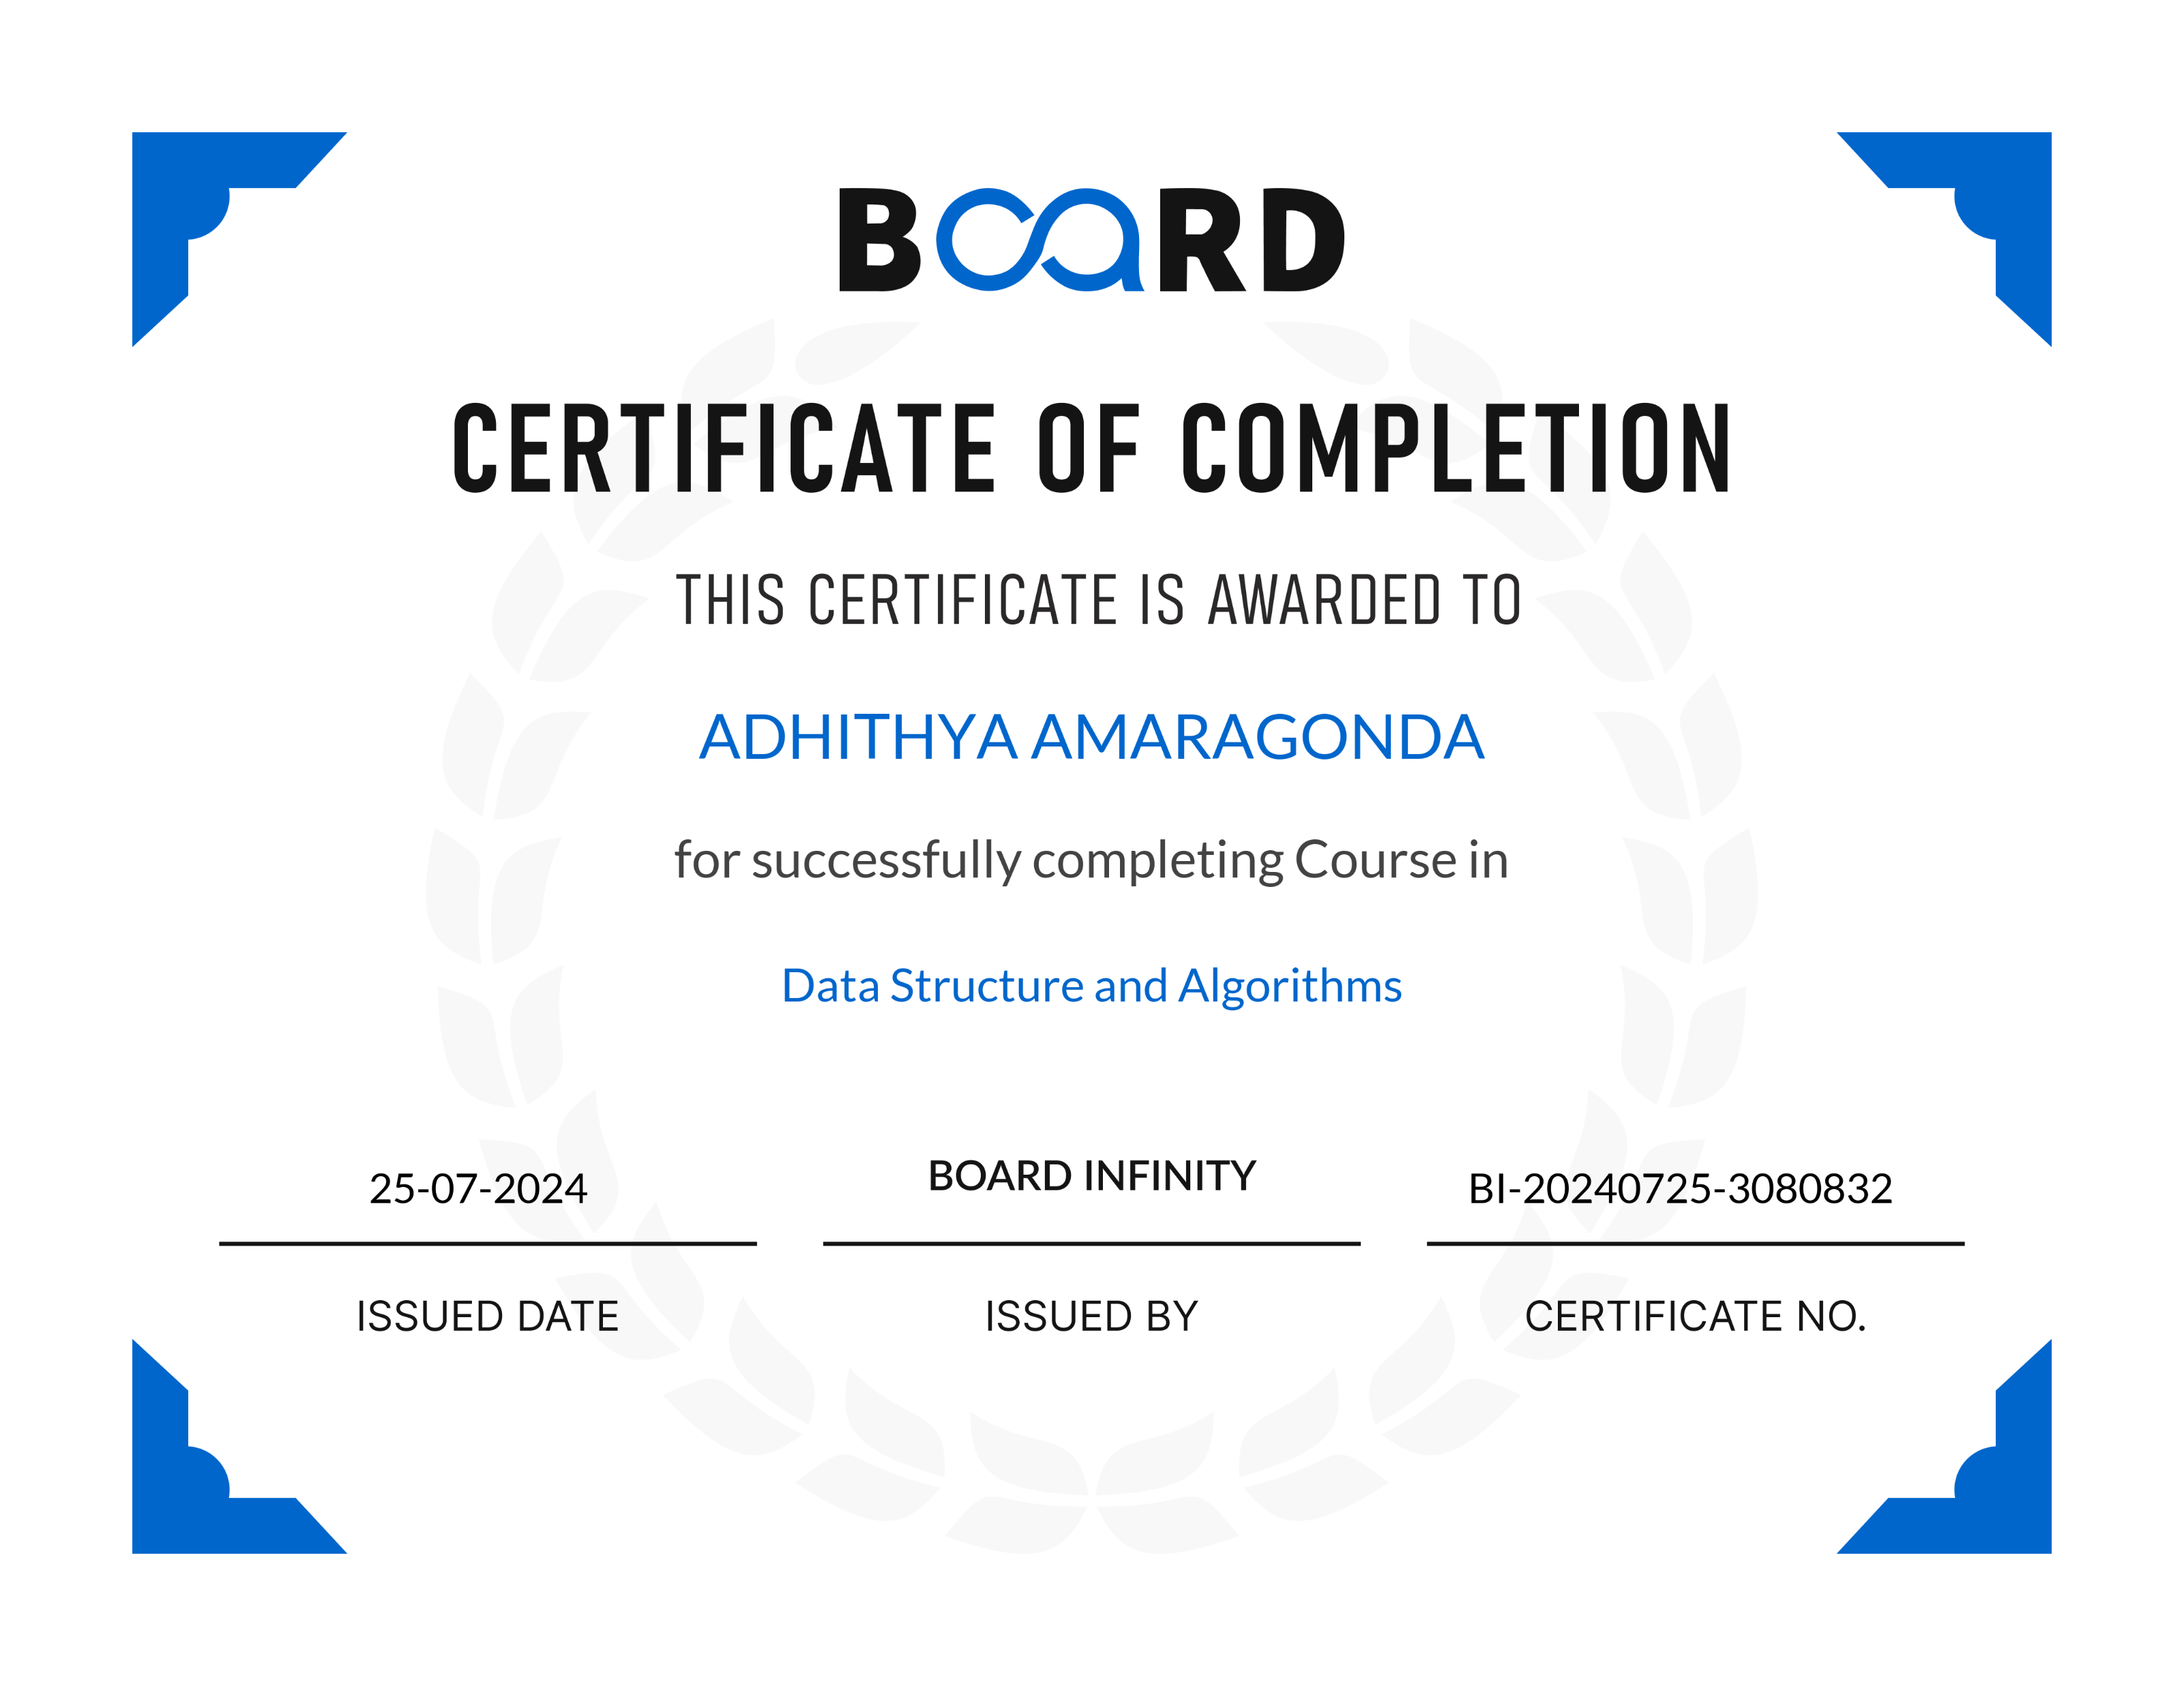
CERTIFICATE:

Slide 6

WHY LIBRARY MANAGEMENT SYSTEM ?
A Library Management System (LMS) is a software application designed to automate and manage library operations such as cataloging, circulation, inventory management, and user management. It simplifies the process of adding and organizing books, tracking borrowed and returned items, maintaining user records, and generating reports on library usage. The system enhances the efficiency and accuracy of library tasks, providing a user-friendly interface for both librarians and patrons, and ensuring secure and easy access to library resources. Overall, an LMS improves the organization, accessibility, and management of library collections.

Slide 7
WHY TO CHOOSE COMPUTERISED LMS OVER MANUAL LMS?
MANUAL LIBRARY MANAGEMENT SYSTEM | COMPUTERISED LIBRARY MANAGEMENT SYSTEM
1. Time-Consuming Processes. | Automated Processes.
2. Prone to Errors. | 2. Higher Accuracy.
3. Limited Accessibility. | 3. Enhanced Accessibility.
4. Inefficient Resource Management. | 4. Efficient Resource Management.

Slide 8
Functionalities of the System:
Book search
Book issue
Book return
User registration
Inventory management

Slide 9
DATA STRUCTURES AND ALGORITHMS USED…
LINEAR SEARCH AND SORTING ALGOEITHM.
1.ADDING A BOOK->PUSH_BACK
2.SEARCHING FOR A BOOK BY ID->FINDBOOKINDEXBYID.
3.SEARCHING FOR A BOOK BY TITLE->ITERATES THROUGH BOOKS VECTOR.

Slide 10
Development Environment
Online C++ Compiler: I used the Programiz online C++ compiler to write and test the code. This platform provides a straightforward interface to compile and run C++ code without the need for local setup.
GNU Compiler: The Programiz compiler uses the GNU Compiler Collection (GCC) to compile the code.
Implementation Details:
The system is implemented using fundamental concepts of C++ including classes, structs, vectors, and basic algorithms like linear search and sorting

Slide 11

Challenges Faced During Development
During the development of the library management system in C++, managing user input efficiently was a significant challenge. Specifically, handling the newline character left in the input buffer after using cinn caused issues when subsequently reading string inputs with getline . To overcome this, cin . ignore() was used to clear the buffer, ensuring accurate input reading. Additionally, ensuring correct deletion of books from the middle of the vector without leaving gaps and implementing a sorting mechanism for books by title were other challenges. These were addressed using the erase function and the sort function with a custom comparator, respectively. Extensive testing, debugging, and consulting C++ documentation and online resources were crucial in overcoming these challenges and creating a functional system.

Slide 12

Expected Learning Outcomes:
This project will help students understand how to use data structures such as arrays, linked lists, stacks, and queues in a real-world application. They will also get hands-on experience implementing search and sort algorithms. It also helps in understanding how to design a simple system and improve problem-solving skills.

Slide 13
CONCLUSION:
A computerized library management system significantly enhances efficiency by automating tasks like cataloging, searching, and tracking books. It reduces human errors, ensuring accurate records of book availability and transactions. Users and staff benefit from quick and easy access to information, improving the overall library experience. The system helps maintain an organized collection, supports detailed reporting for informed decision-making, and easily scales with the addition of new books and users. Enhanced security features protect data from unauthorized access, ensuring integrity. Overall, this system streamlines operations, boosts accuracy, and elevates user satisfaction, making it essential for modern libraries.

Slide 14
THANKS GIVING!
AMARAGONDA ADHITHYA
12212304

